Slide 1


Name: Mukul Chaurasiya
B.Sc. ( Mathematics )

Slide 2
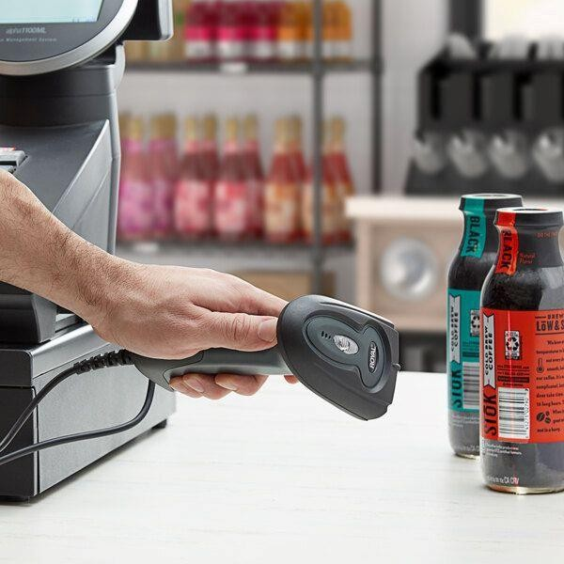




A barcode scanner is an input device that reads barcodes, which are patterns of dark bars and spaces ,to capture information encoded within them .This information is then transmitted to a computer or other device for further processing .

Slide 3
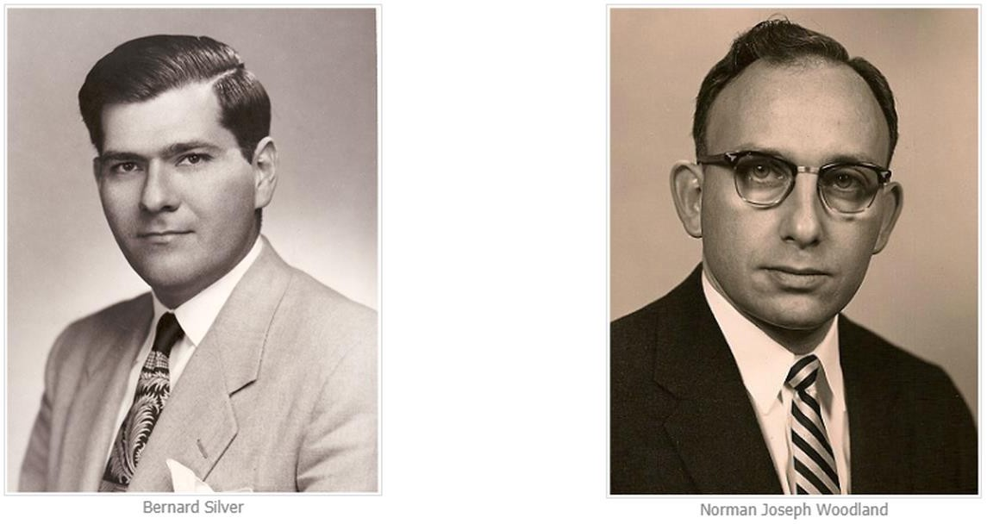
Barcode
The barcode was invented by Norman Joseph Woodland and Bernard silver in 1949.they were inspired by morse code and developed a system of lines and spaces that could be read by a machine.
The first barcode was scanned on June
26,1974,at a marsh supermarket in troy
,ohio (USA).

Slide 4

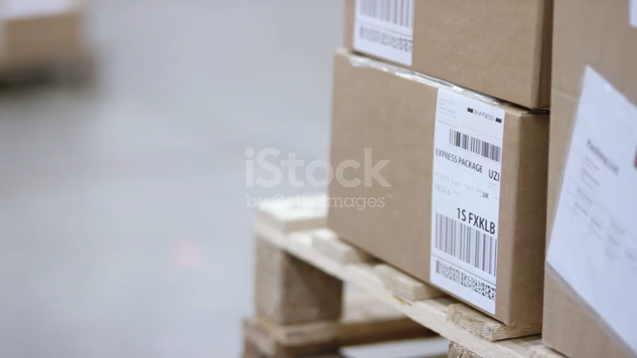
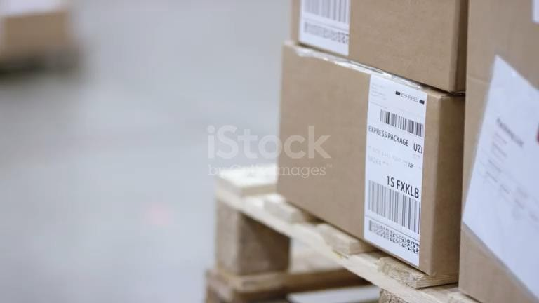
A barcode scanner works by shining a beam of light onto a barcode and measuring the amount and pattern of light that reflects off of it.
The working of a barcode scanner is as follows:
Barcode scanner have a built-in light.
The scanner shines this light onto the barcode.
The scanner’s photodiode(or photo detector ) and sensor capture
the light reflected form the line and spaces on the barcode .
The scanner converts light energy into electrical energy.
The scanner recognizes barcode symbols by analyzing image data form the sensor.
The decoder recognizes barcode symbols by analyzing image data from the sensor.
The decoder translates bar and space content and sends the data
into computer.
Software on a computer converts data to the information .

Slide 5


Slide 6

Reducing human error: Barcode scanners automatically translate scanned labels into a software application , which can significantly reduce human error.
Improving inventory management : Barcode scanners can help accurately count inventory yields and calculate inventory turnover rates. This can help businesses hold less inventory and reduce carrying costs.
Reducing time consumption : Barcode scanners can help reduce the time needed to complete daily tasks.
Saving resources : Barcode scanner can help save resources.

Slide 7



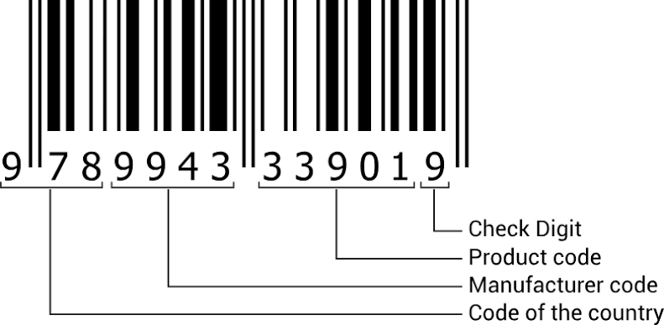


Slide 8
COUNTRY CODE SAMPLE
❑ | Country | Code
1. | India | 890
2. | Australia | 930
3. | China | 690
4. | Iran | 626
5. | Japan | 490
6. | Singapore | 888
7. | Pakistan | 896

Slide 9

Barcode scanners are a powerful tool that can help businesses improve efficiency, reduce errors , and streamline processes. They can bee used in a variety of industries , including retail and healthcare. Here are some concluions about barcode scanners:
Improve inventory management
Optimize supply chain management
Reduce human error
Conserve resources
Gain a competitive edge

Slide 10


